Slide 1
SMARTCART
SE Associates Degree Capstone 2018
Developed by: Brian Colantonio

Slide 2
What is smartcart?
And what did it take to get it running?

Slide 3
Timeline:
Early stages
Researching APIs
Comments and light coding
API implementation
Needing more data from API calls
Reevaluating API
Late stages
Spoontacular API
Getting hands dirty with Composer Library Manager/PHP/Javascript etc.
Formatting and displaying JSON

Slide 4
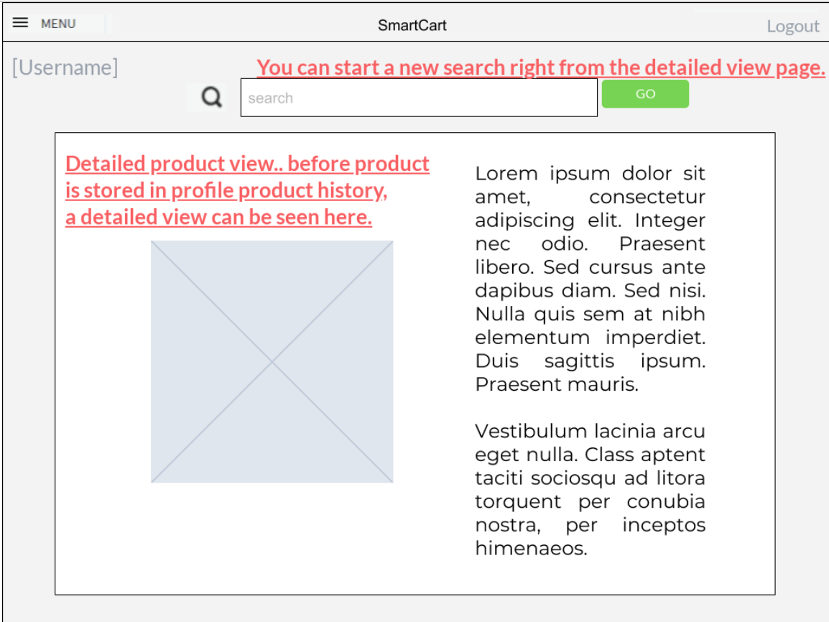
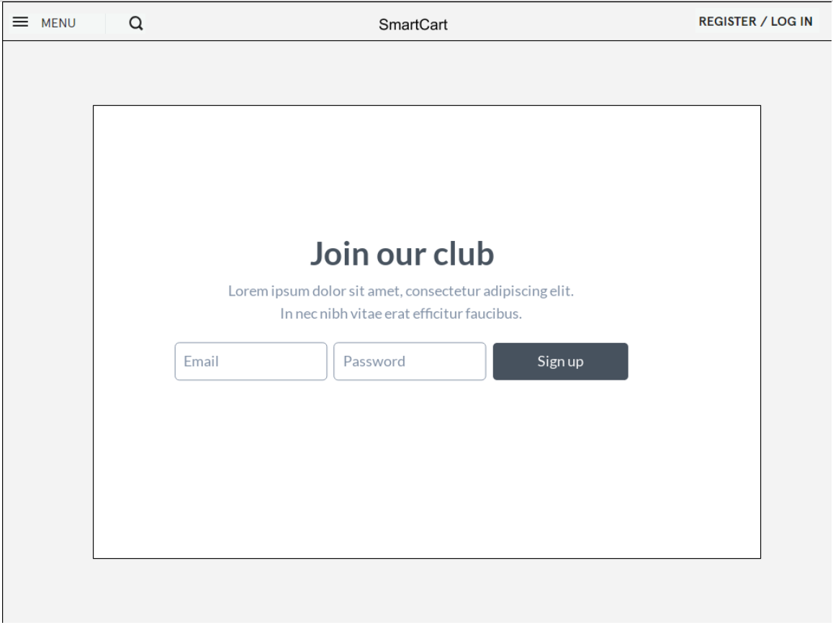
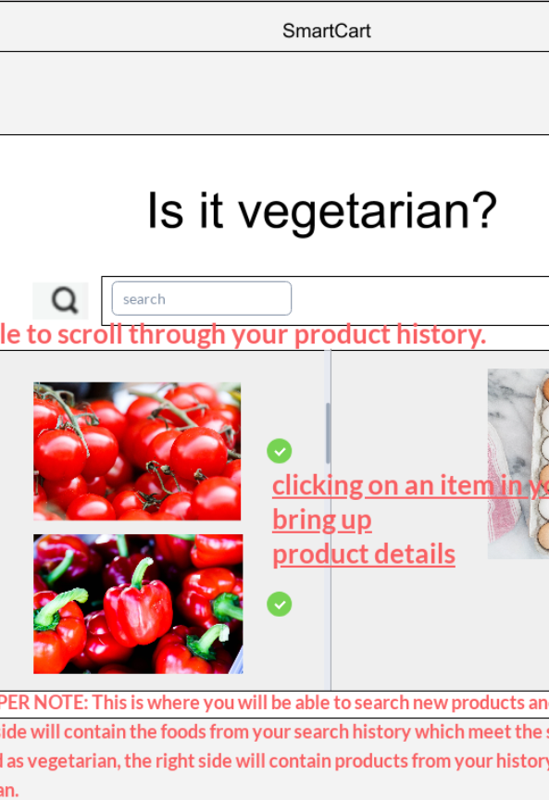
Preconceived Notions
“This wont be too difficult”
“Most of the code will be in vanilla PHP”
“I’m not going to ask for help, I got this.”

Slide 5
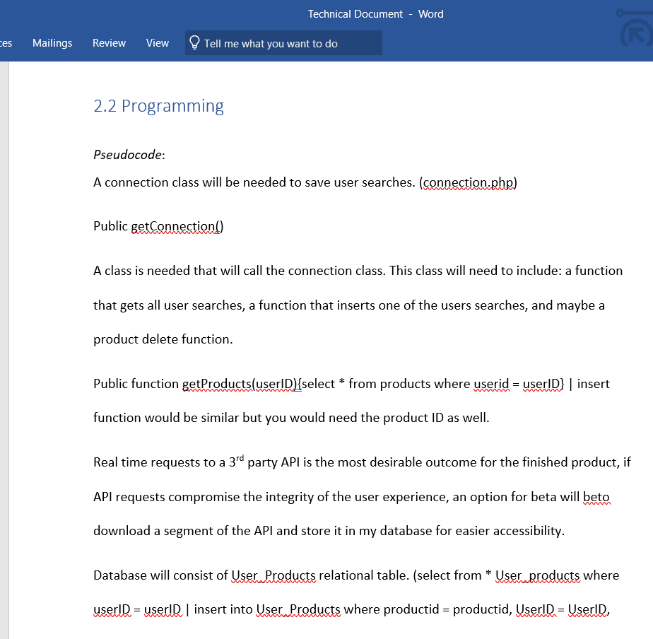
What I thought was going to happen…
What did happen.
The external 3rd party API I had originally chosen wasn’t going to work.
Spoontacular API was found and implemented
API EDK had to be installed with COMPOSER dependency manager
API came with several folders worth of files with precoded functions. Felt like I was learning a new coding language.

Slide 6
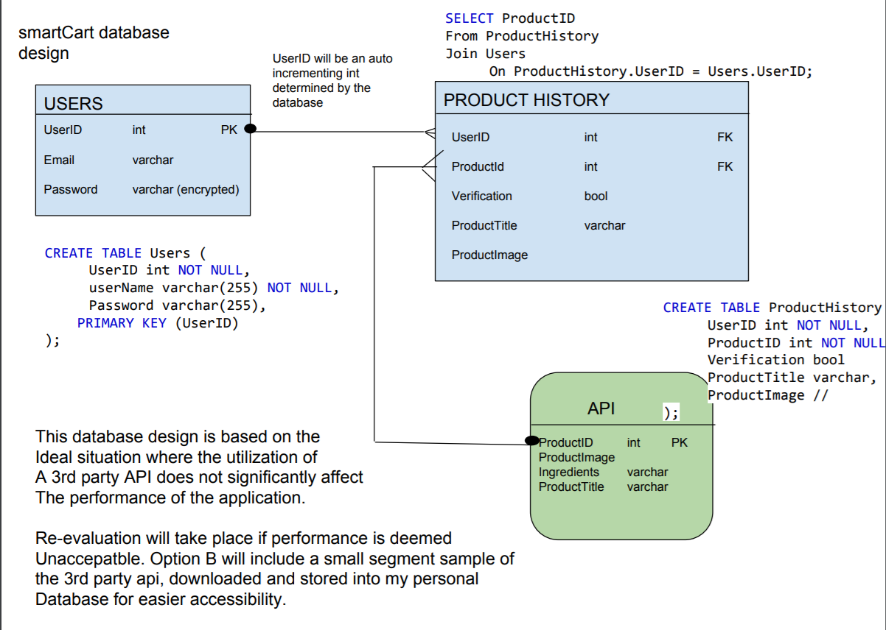

Slide 7
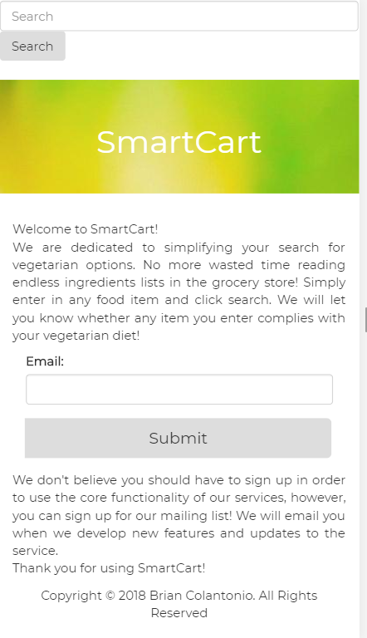
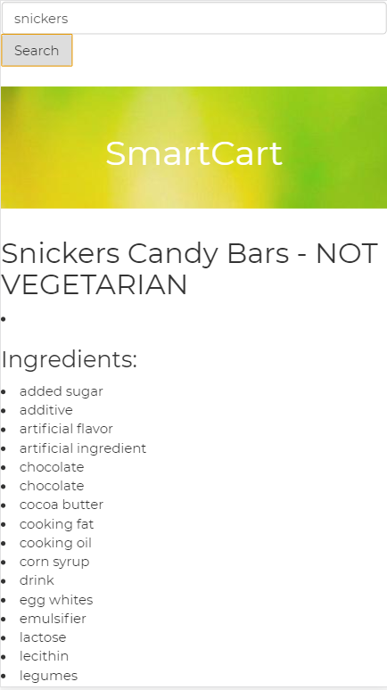

Slide 8

Summary
SmartCart has opened my eyes to how much work is necessary when planning a project.
Missing functionality and the need for more rigid time management.
Anticipating completion and further development. (more dietary preferences, allergies, etc.)

